Slide 1
Bootcamp Capstone One
Mock Project Walkthrough
Monday December 14, 2020

Slide 2
Index
User Case Description
User Flow
Web Stack
Functionality Design
Flask/SQLAlchemy
Database Schema
External API
Deployment / Maintenance
Design & Implementation Challenges
Future Developments

Slide 3
Use Case Description
Purpose
To create a website that helps users find the best rewards credit card for their needs.
Overview
The app provides users with a comprehensive list of rewards credit cards available on the web, while helping them find the credit cards that maximize the rewards dollar value of their everyday spending habits.
Contrary to similar webs available, this is an independent app that has no comercial strings with credit card companies.
Actors
Anyone shopping for a rewards credit card:
Is my current credit card good enough? Can I find a better one?
I got this credit card offer in the mail, is it good enough?
Product managers from credit card companies may use the app as a central repository of card offers and value propositions available in the market.

Slide 4
User Flow
This app is designed to help users find and apply for the best rewards credit card for them in 3 easy steps:
Step 1
Step 2
Step 3
All Cards
Filter Cards
Fill out spend form with spend habits
Find the card that maximizes your rewards and Apply!
User is presented with an HTML table with 350+ rewards credit cards.
Base info on each credit card includes card name, rewards program, rewards rates range, intro bonus, annual fee, and foreign fee.
User can use button to expand/collapse additional details on each card.
User may choose to narrow down the list by using any of the available filter options:
- Rewards Program (cash, miles, points)
- Earning Categories (airlines, hotel, dining, gas station, groceries, etc.)
- Credit Card Companies
- Only show cards with Intro Bonus, No Annual Fee, or No Foreign Fee
User may choose to enter monthly spend in all or any of the 15 spend categories available in the form.
Upon form submission the dollar value of the estimated rewards earned in the first year is calculated and added to each card on the table.
User clicks apply button to be redirected to an external site.

Slide 5



Web Stack
Client (Frontend)
Server (Backend)
Database (Backend)
SQLAlchemy
psycopg2
HTML/JS/CSS
jQuery
Flask
Jinja
PostgreSQL
psql < seed.sql
External API

Slide 6



Functionality Design
Client
Server
Database
Functionality
+ Table Pagination is updated as the searching functionality is used
Live
Search Bar
User
+ Form input amounts and calc’d rewards value are sent to Local Storage
Submit Spend Form
AJAX
+ Full Page Reload
+ User’s Filter Selections are sent to Local Storage
Filter Cards
Expand Card Details
Apply for Card
+ Redirected to external site

Slide 7
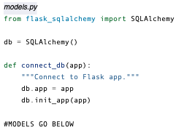
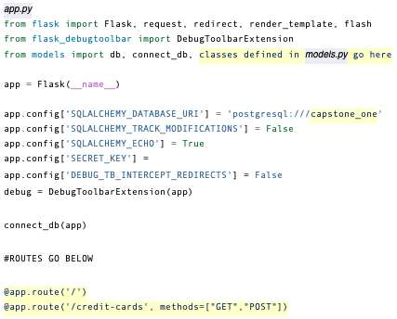
Flask / SQLAlchemy
Used a conventional setup which uses 2 files:
1. models.py 2. app.py

Slide 8


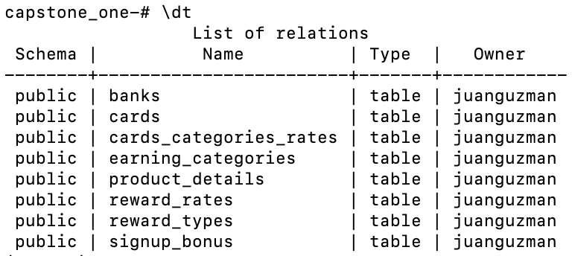
Database Schema
Organized tables in a manner that reduces redundancy and dependency of data.
PostgreSQL Database:
Name: capstone_one
Number of tables: 8
Number of joins: 7
Number of join tables: 1

Slide 9
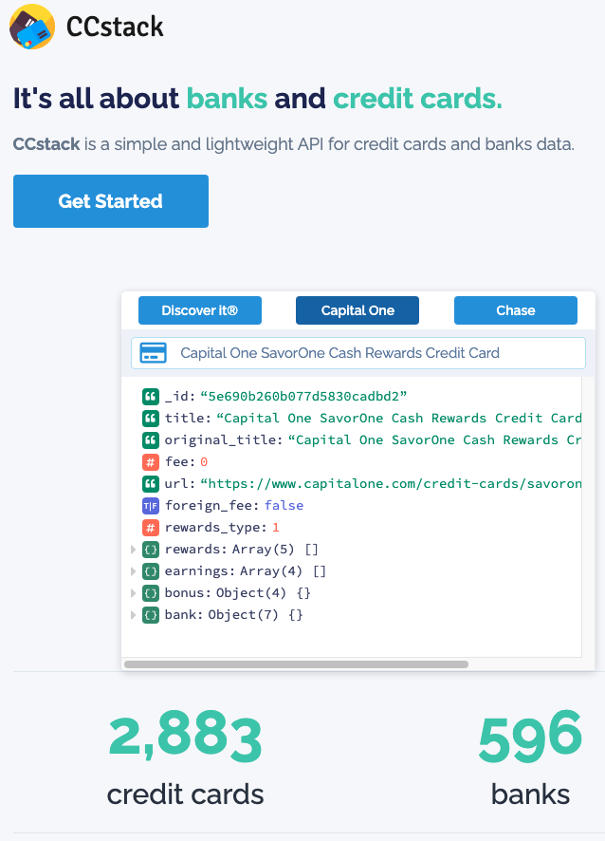

External API
The project database was populated with credit card data obtained from external API CCStack (https://ccstack.io/). Their basic plan at $29.99 / mo provides access to their Card, Rewards, Earnings, Bank, and Bonus modules.
This API service is the only one I could find that would provide this kind of information on US credit cards.
The data provided by this API turned out to be messy data, filled with inconsistencies (missing data, duplicated data, outdated data) and therefore it is unreliable and not fit to be used in a production environment.
According to their technical support their data is purged from different sources over the internet and sometimes those sources have outdated data, making the API data outdated. In addition their process is only run monthly.
As far data inconsistency, they advised that they are planning on improving AI to detect card information better.

Slide 10
Deployment / Maintenance
The app was deployed with Heroku:
URL: https://rewards-cards.herokuapp.com/credit-cards
However, because of the quality issues with the data from the external API, the app database has not been refreshed with more current card information since the app was first deployed back in August.

Slide 11
Design & Implementation Challenges
There were a number of design issues and roadblocks when creating this application. The table below provides an illustration of these issues and workarounds which were put in place to overcome them. Some of the issues could not be resolved due to time and depth of knowledge required to fix them. Therefore, the more difficult issues will be investigated and included within future releases of the application.
# | Issue | Corrective action
1 | Messy, inconsistent data from external API. | Lots of data cleaning and preparation were necessary prior to seeding my database. Further data improvements and mappings were implemented on the server side in order to provide the user with better app features.
2 | List of Credit Cards is presented to the user in an HTML table. Each row in the table represents a credit card. Following each row there is a hidden row that can be expanded to display further details on each card. This design decision to include the collapsible rows turned the HTML table into an “unconventional” table, which resulted in an inability to use a table plugin for client-side sorting, pagination, and live searching functionalities. | Manual implementation of pagination and live searching functionalities. Implementing such functionalities was a very time consuming process taking time away from other planned tasks.
3 | Following up on issue #2, client-side sorting could not be implemented. This is an important drawback as at the moment the calculated rewards value can’t be displayed from highest to lowest, as I had intended originally. | Further research required in regards to how to sort a table with hidden rows.
4 | Missing card images. API service does not provide an image for each card. | A generic placeholder image for each card was used instead.
5 | Functionality testing of the app has found an inconsistent behavior of the spend form when Safari and not Chrome is used. Safari does not let user to move from one input field to the next. | This will be researched for future releases.

Slide 12
Design & Implementation Challenges (cont’d)
# | Issue | Corrective action
5 | Functionality testing of the app has highlighted an issue with the use of “display: none” in CSS where a number of HTML elements are expected to start as hidden elements and they should then be displayed in response to user’s actions. However this behavior is not working in some instances. | This inconsistent behavior will be researched and rectified in the next release.
6 | Functionality testing of the app has found an inconsistent behavior of local storage. Local storage was working fine when tested for the first release. | This will be researched and rectified in the next release.

Slide 13
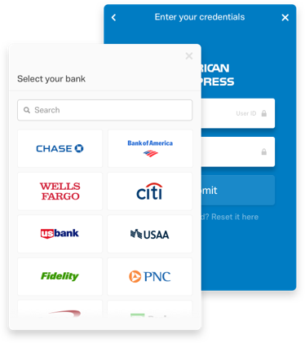
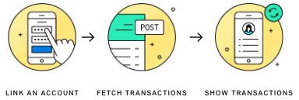
Future Developments
This application is currently more than just a prototype as a good deal of the functionality is working as part of this first release. However, it could benefit from a number of future developments that will make the app more useful. Taking into account the other products on the market, the current app is a relatively simple app with this first release. However, the developments below could potentially bring the app in line with some of the competitors in the market.
The items in the table below have been identified as future improvements for the app.
Ref | Improvement | Comment
1 | Due to the issues with the external API, the external API will be replaced with a new API that I will build in-house. | This project will be tackled in my Capstone Two project. The project proposal has already been approved. Credit card data will be gathered from the internet via web scraping with Python and Beautiful Soup. Node.js/Express.js will be used on the server side.
2 | Replace user’s manual population of amounts in the spend form with an automated population using credit card transaction history from plaid API. ( https://plaid.com/products/transactions/) | Users of the app will be asked to select a bank, then to enter their bank credentials, and the app will retrieve from plaid API 24 months of credit card transaction data, including merchant, and category information, which will be populated into the spend form in the app and presented to the user if they want to make changes.

Slide 14


